Slide 1
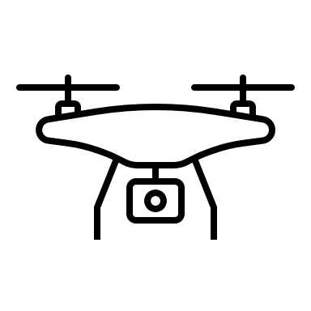
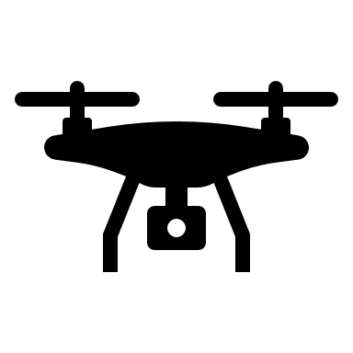
Drone Shooter A Real-Time and Automatic Anti-Drone Jammer
Hala Hosni Amin (201508473)
Maria Rauf Mahsood (201708075)
Supervisor: Dr. Abdulla Khalid Al-Ali

Slide 2
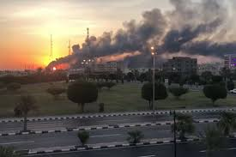
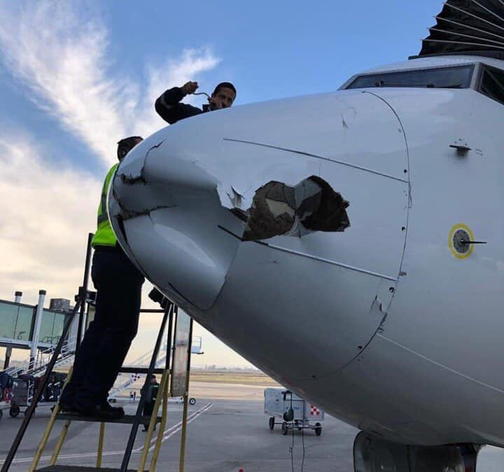
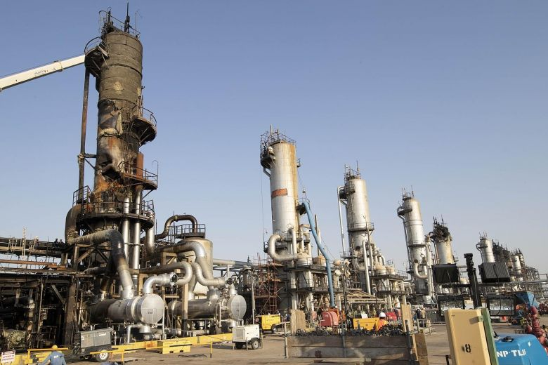
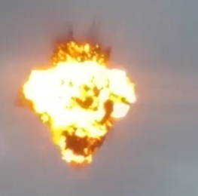
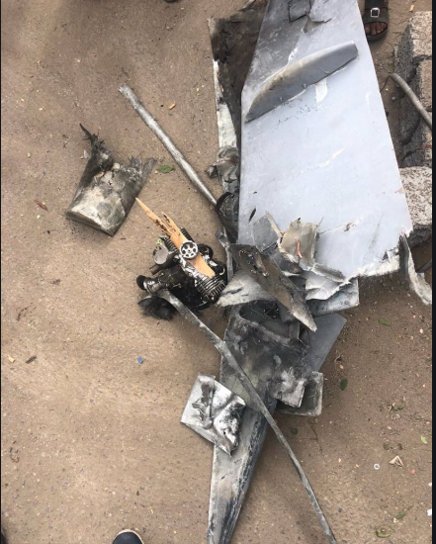
THE Problem
Worldwide Drone Incidents:
Hitting an oil installations in Saudi Arabia [1].
30 minutes disruption in Dubai’s airport [2].
Landing in the front of the lawn of the White House [3].
Drone Risks:
invade citizen’s privacy
spying on governments and militaries
carry an explosive materials and threaten people’s lives

Slide 3
Table of Contents
Solution
System overview
System design
Testing
Evaluation of Impact
Conclusion
Future work
References

Slide 4
Solution
The pre-developed system was able to:
Detect, Localize and Track using machine learning
Detect Track and Jam using Radar
Detect Localize and Jam using machine learning

Slide 5
Solution
Develop an anti- drone system based on video surveillance that can defeat the malicious actions conducted by the drones.
It is capable of:
Detecting drones in omni directional coverage using machine learning.
Localizing and Tracking drones in real time.
Jamming the Wi-Fi controlled drones.

Slide 6
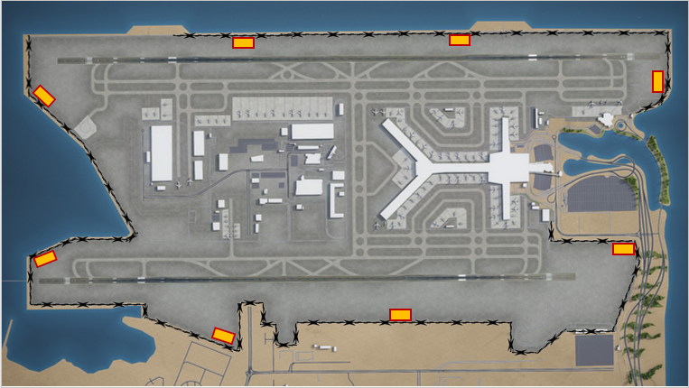
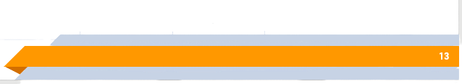
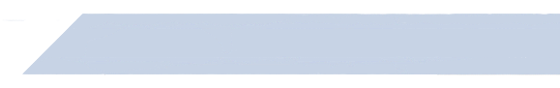
SYSTEM OVERVIEW
Airport Example

Slide 7
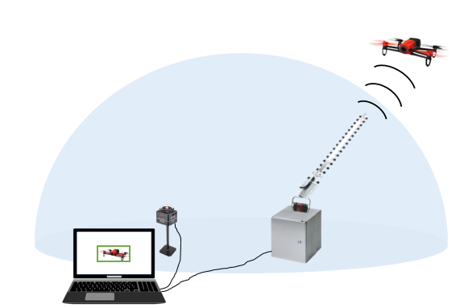
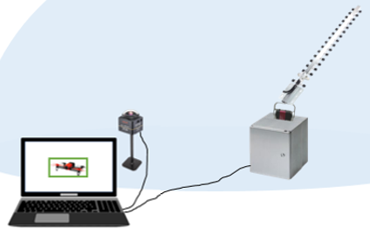
System Overview

Slide 8
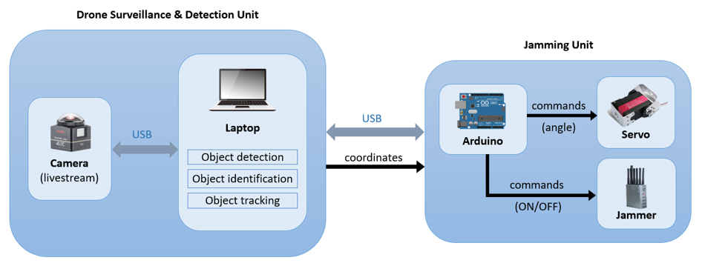
System Overview

Slide 9
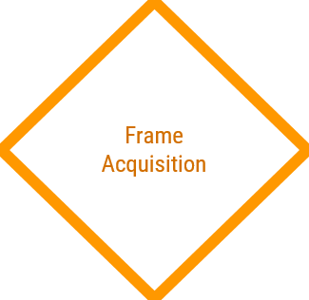
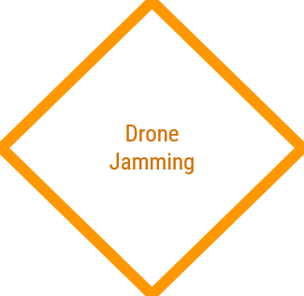
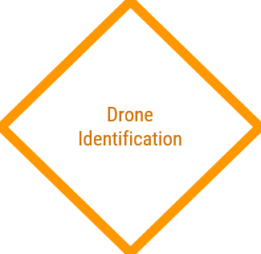
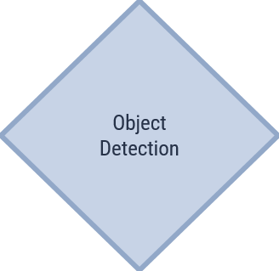
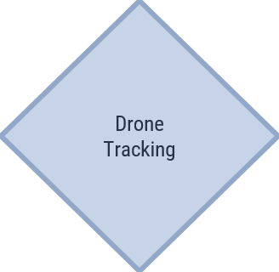
Start
System Design

Slide 10
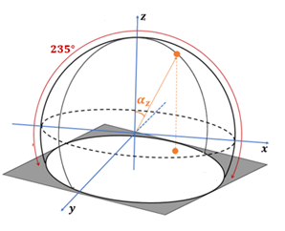



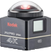
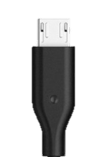
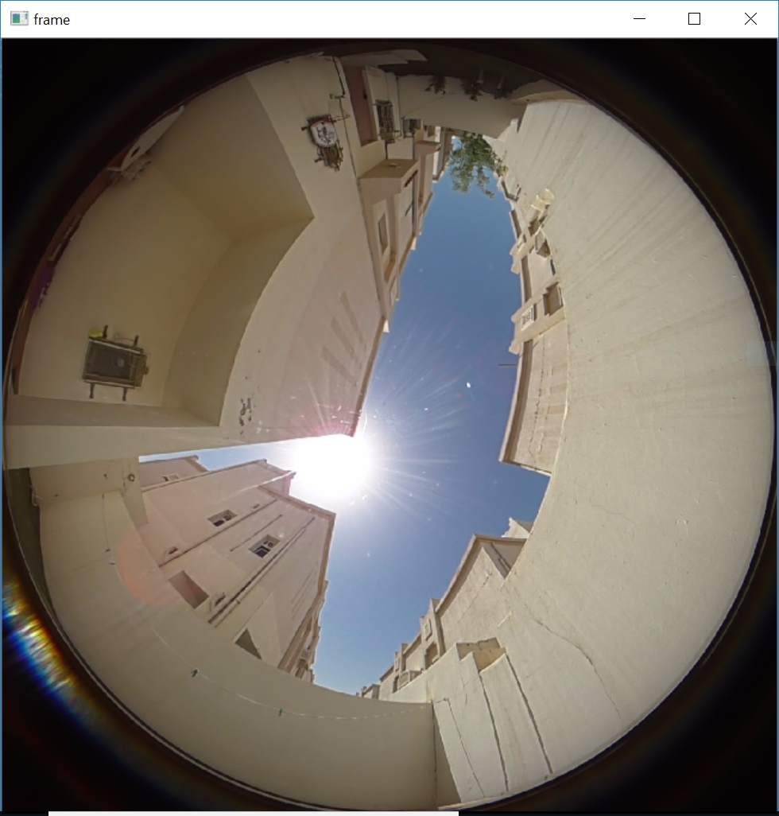
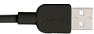
Frame Acquisition
The output of this stage is a frame
Local PC
2.0 micro USB
2.0 USB
360°
Fisheye camera with view of 360 horizontally And 235 vertically

Slide 11
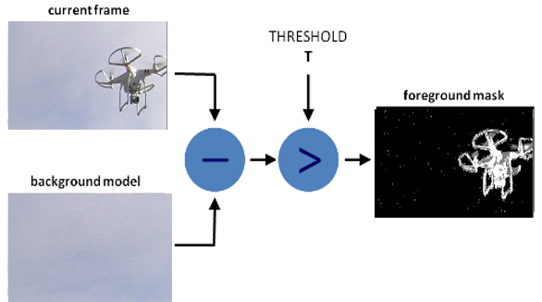
Object Detection
Local PC
Implementing Adaptive Background Subtraction using OpenCV
The output is a frame with the detected region of interest (ROI) of the moving object.

Slide 12
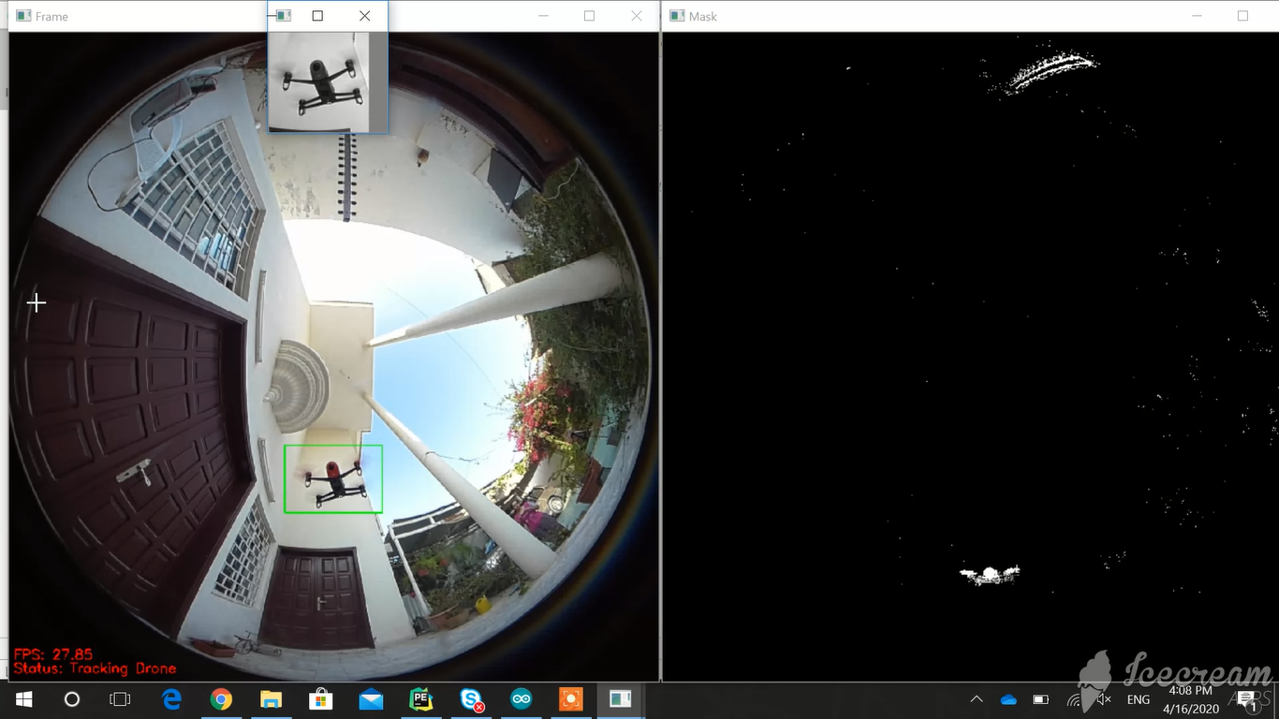
Drone Identification
CNN Model
Drone
Not Drone

Slide 13

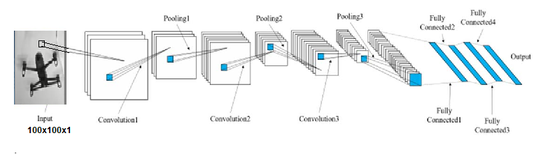
Drone Identification
Local PC
Preparing the data for training and testing the machine learning model
Dataset of 2900 drone images and 2900 not drone images.
Divided to 70% training and 30% testing.
CNN Model Architecture
0
1

Slide 14
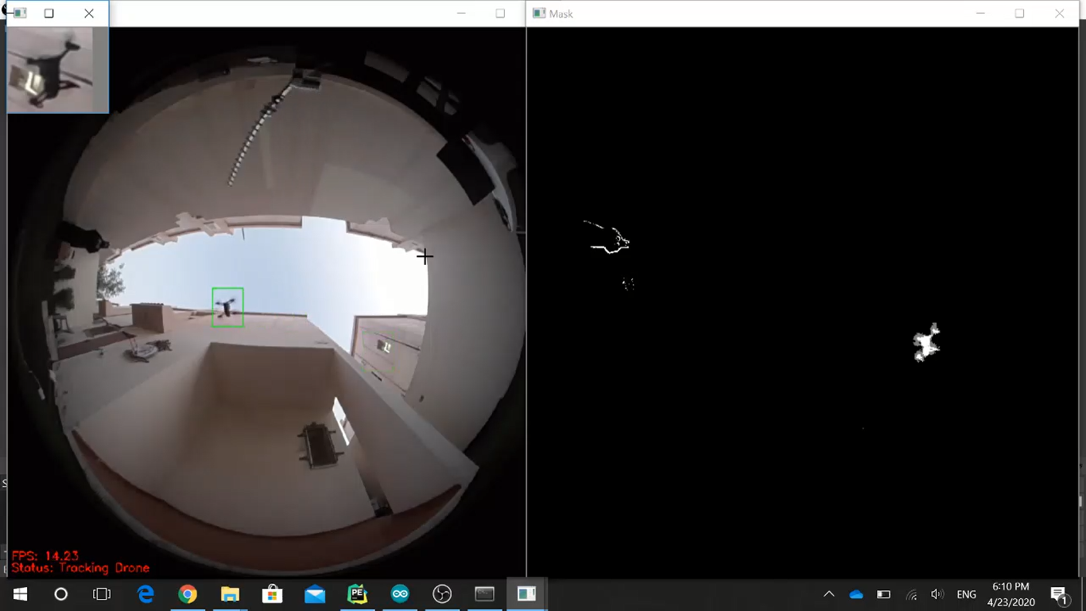
Drone Tracking
Local PC
Follow identified drone between frames.
Implemented using OpenCV fast tracker MOSSE
Output: tracked drone bounding box coordinates.

Slide 15
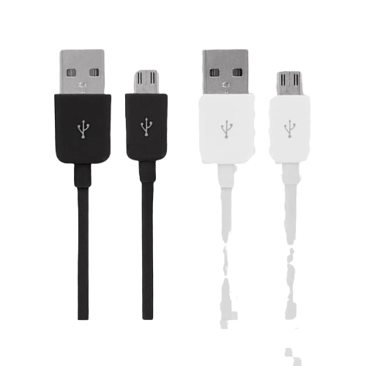
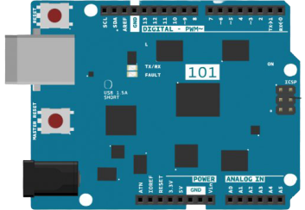
Drone Tracking
Communication between Drone detection Unit and Jamming Unit
python sends coordinates to Arduino over USB
<Drone coordinates>
USB 2.0 A-B
Local PC
Arduino UNO

Slide 16
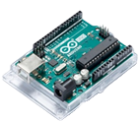
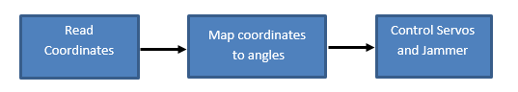
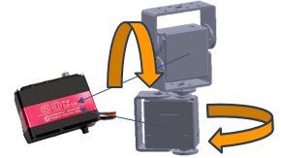
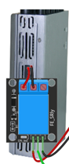
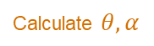
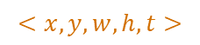
Drone Jamming
Arduino UNO
$$<x,y,w,h,t>$$
Calculate $θ, α$
Point Antenna at drone
and activate jammer
Send jamming signal in 2.4GHz band to jam detected drone
Arduino UNO is used as the jamming unit controller to
Arm
Jammer
Relay
Servo

Slide 17
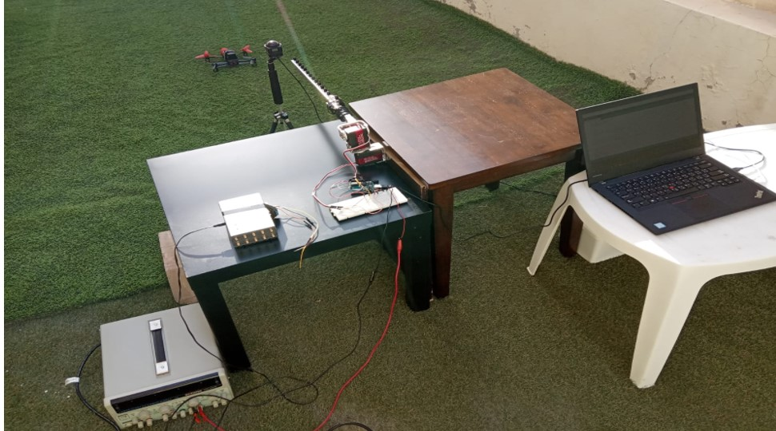
Drone Shooter System

Slide 18
Testing
Technical Constraints
80%
Range: detect and jamming at least 10 meters away
Justification: CNN model at far distances
87%
Accuracy: Drone tracking in dome view and having more than 85% detection and identification accuracy
Justification: Drone tracking in the area between the camera and the motors and the area beside both of them.
.
100%
Response Time: total delay should not exceed 0.5 sec
100%
Angle Coverage: ability to detect and track in a hemispherical field of view and having a 45-degree directional antenna
100%
Jamming Frequency: Jamming in the 2.4GHz spectrum
100%
Input: Single moving object detection

Slide 19
Testing
Functional Requirements | Tests Justifying the Functional Requirements (MET) | Status
Frame Acquisition | Test 3.1, 4.1 | 100%
Object detection | Test 2.1, 3.2 | 100%
Drone identification | Test 1.1, 2.2, 3.3 | 87%
Drone tracking | Test 2.3, 3.4, 3.5 | 87%
Drone jamming | Test 1.2, 3.6, 3.7, 4.2, 4.3, 5 | 100%

Slide 20
Evaluation of Impact
Global
Economical
Competitive edge
Knowledge-based economy
Environmental
Prevent damage from explosions
No adverse effect
Societal
Protect privacy
Better job opportunities
Human well-being
4IR
High
High
Medium
Medium

Slide 21





Conclusion
Hexagon Lines Process – Slide Template
Designing and implementing an effective solution
Evaluate the functionality of this system
Security breaches of the UAVs
Pre-developed solutions
Knowledge based Economy, Qatar Vision 2030

Slide 22
Future Work
Use a laser range finder sensor
Incorporate GPS and Wi-Fi 5/5.8GHz jamming
Use industrial-grade servo motors with 360-degree motion
Add an IR camera for night-vision
Develop anti-drone system with two fish-eye camera
Develop a mobile application
Utilize multiple anti-drone modules

Slide 23
References
[1] | B. Hubbard, P. Karasz and S. Reed, "Two Major Saudi Oil Installations Hit by Drone Strike, and U.S. Blames Iran," The New York Times, 2019. [Online]. Available: https://www.nytimes.com/2019/09/14/world/middleeast/saudi-arabia-refineries-drone-attack.html.
[2] | J. Porter, "Dubai airport forced to halt departures due to drone sightings," 2019. [Online]. Available: https://www.theverge.com/2019/2/15/18226077/dubai-airport-drone-closure-ground-flights.
[3] | I. Kuksov, "Air alert: 8 dangerous drone incidents," 2019. [Online]. Available: https://www.kaspersky.com/blog/drone-incidents/29000/.

